Slide 1

Inventory Management System for a Local Farmer’s Market
Team –01
Jeet R Patel | Shubh Vivek Patel | Omkar Datta |Jagruth Reddy | Bhanu Prakash Reddy |Manasa Tallapaka

Slide 2
Index:
Introduction
Proposed Solution
Requirements System Design (ERD)
Database Schema
Implementation Features
Testing and Validation
Teamwork and Collaboration
Results
Conclusion

Slide 3
Introduction:
Content:
Problem Statement:
Farmers struggle with managing inventory, seasonal demands, and customer preferences.
Common issues: overstocking, stockouts, and a lack of actionable insights.
Objective:
To design a system that provides real-time inventory tracking, sales monitoring, and seasonal trend analysis.

Slide 4
Proposed Solution
System Overview:
A centralized system for inventory management and sales tracking.
Predicts seasonal demand to optimize stock levels.
Key Benefits:
Reduces waste.
Prevents stockouts or overstocking.
Provides actionable insights to vendors.

Slide 5
Continue..(Solution)
Real-time Inventory Tracking:
Prevents overstocking and stockouts.
Sales Data Optimization:
Generates insights from sales and customer preferences.
Seasonal Trend Prediction:
Forecasts demand using historical data.
Enhanced Vendor-Customer Interaction:
Tailors' offerings based on top-selling items and trends.

Slide 6
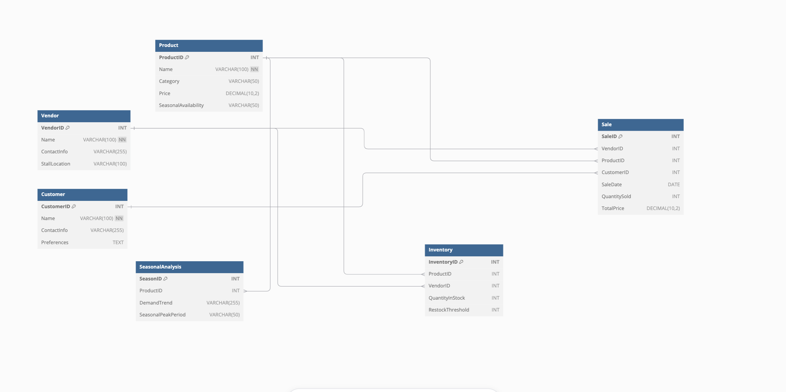
System Design (Main ERD Diagram)

Slide 7
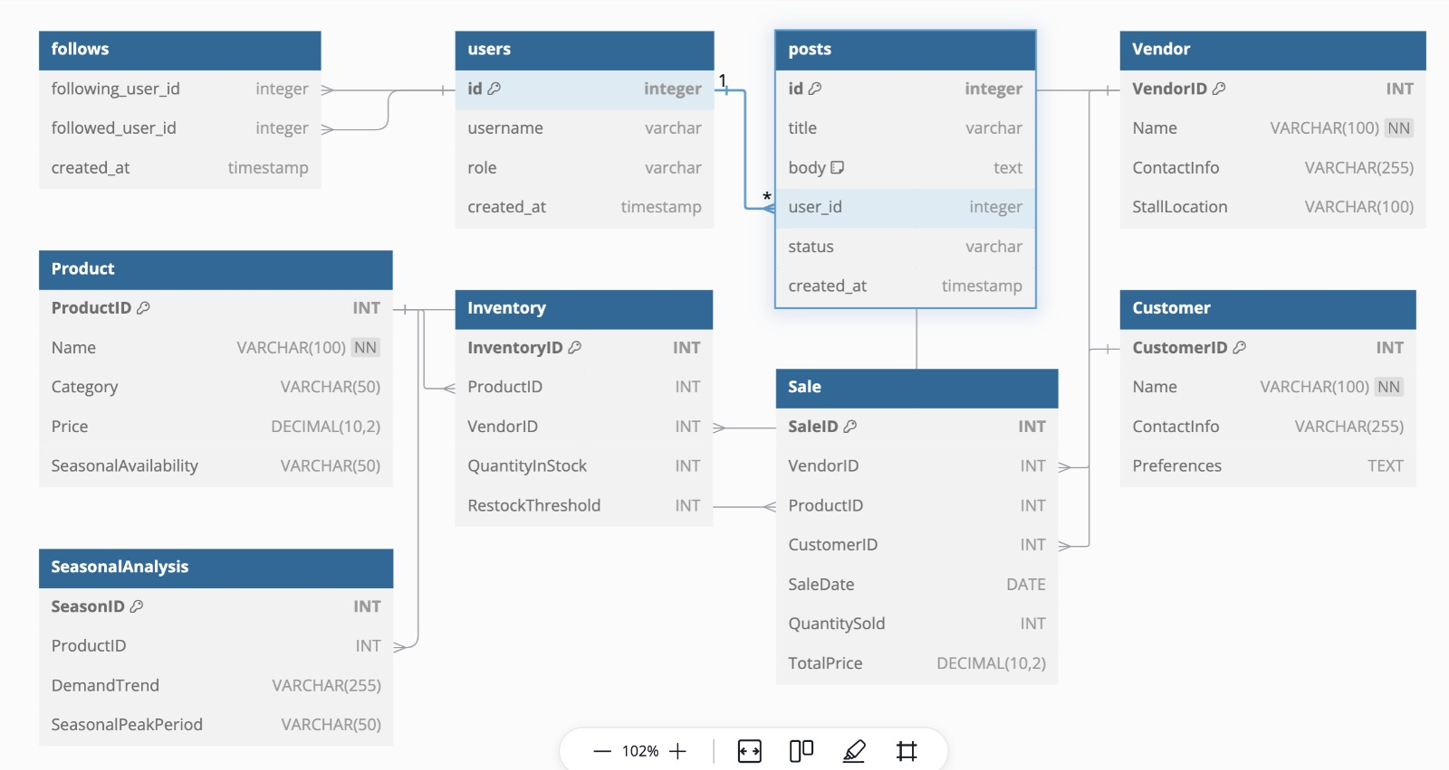
Detailed ERD with Their subcomponents:

Slide 8
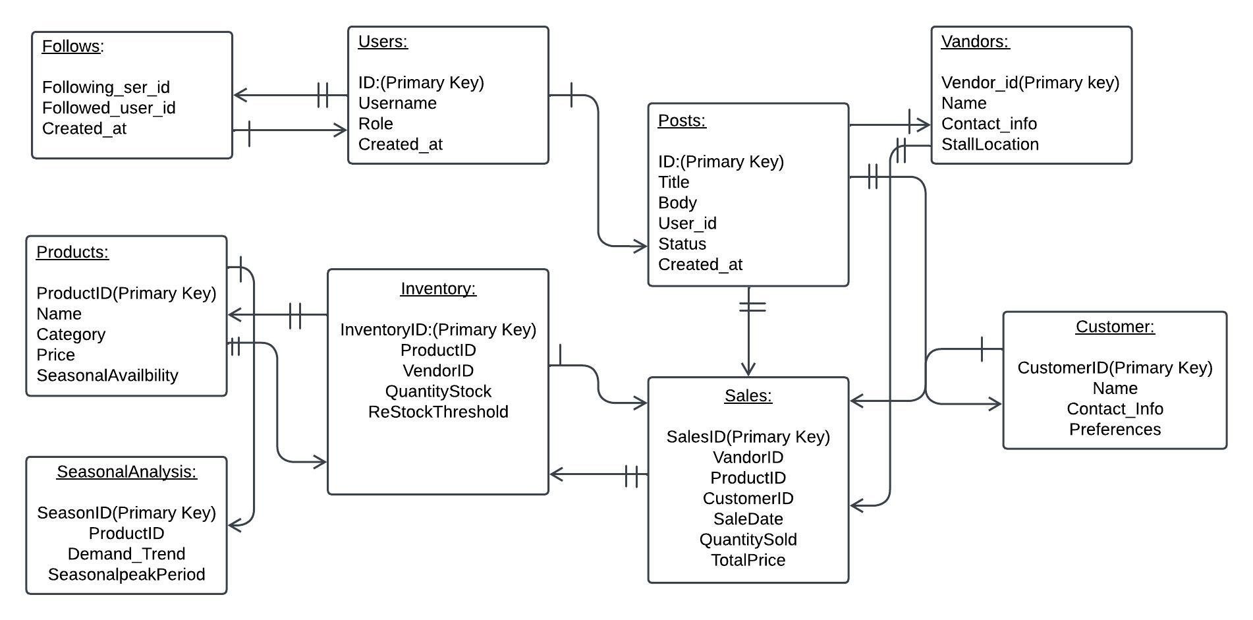
Structured ERD:

Slide 9
Database Schema
Tables and Keys:
Vendor: Tracks vendor details (Primary Key: VendorID).
Product: Stores product details (Primary Key: ProductID).
Inventory: Links vendors and products (Primary Key: InventoryID).
Sale: Records transactions (Primary Key: SaleID).
Customer: Tracks customer data (Primary Key: CustomerID).
SeasonalAnalysis: Analyzes trends (Primary Key: SeasonID).

Slide 10
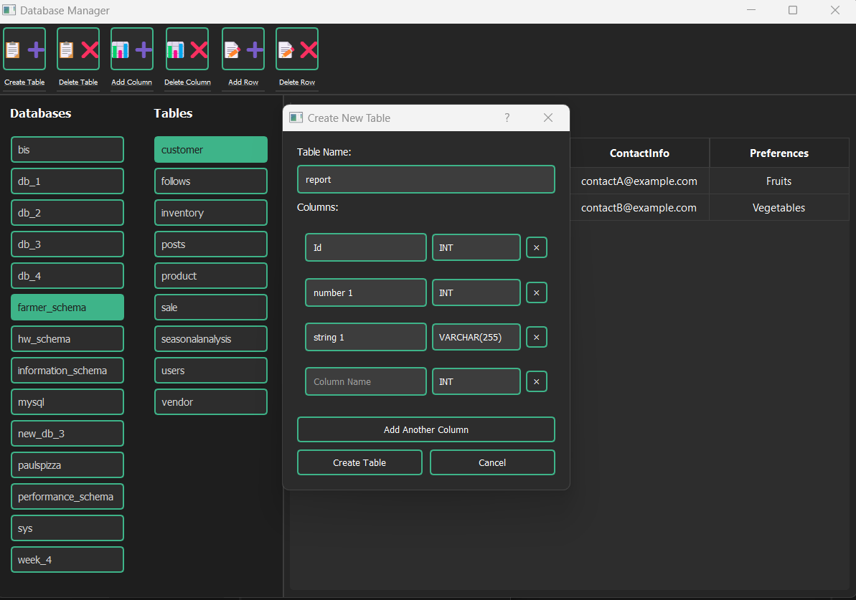
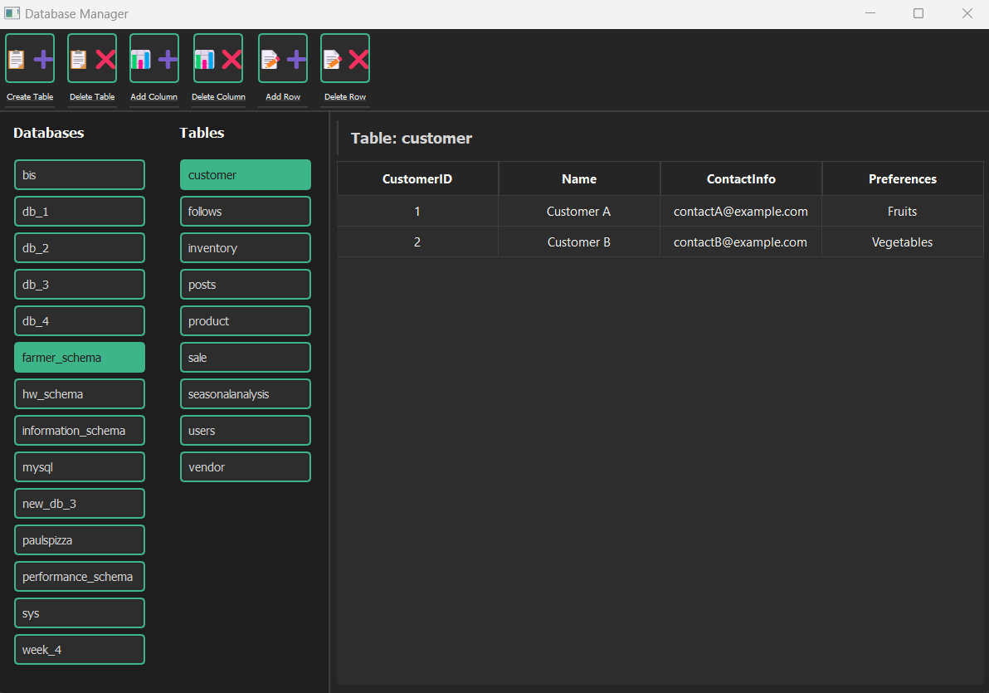
Creation of Tables and Insertion of Data:

Slide 11
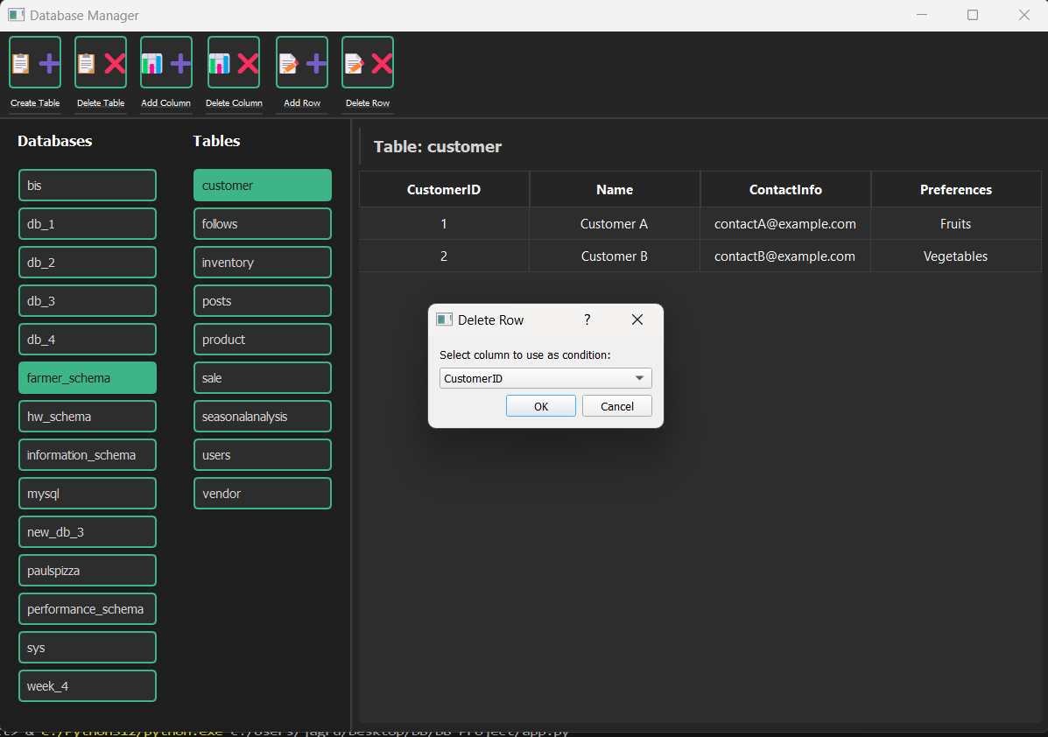
Deletion:

Slide 12
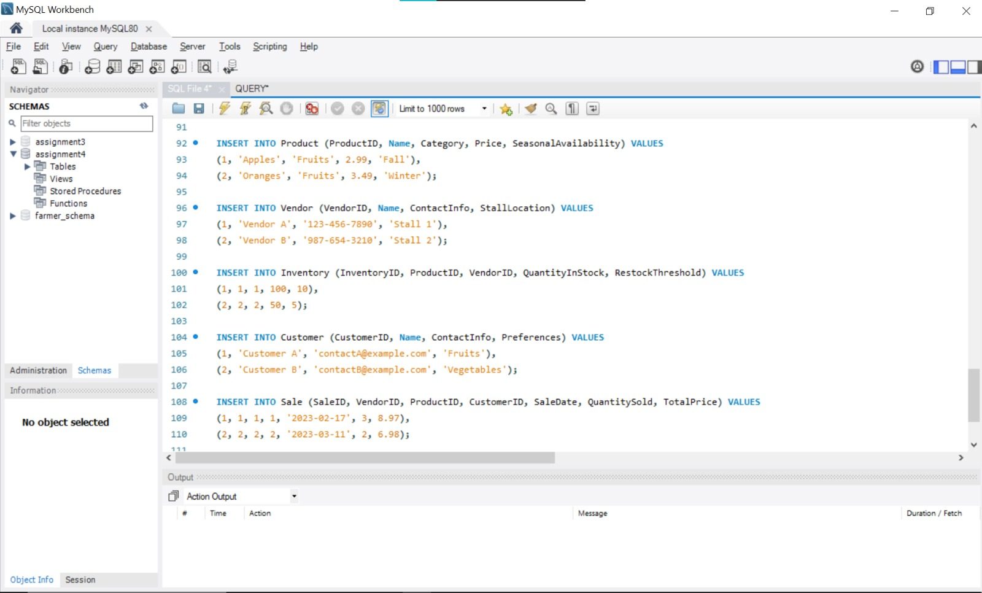
Insertion:

Slide 13
Implementation
CRUD Operations:
Create: Add vendors, products, and sales records.
Read: Retrieve inventory reports and sales data.
Update: Modify vendor details or inventory levels.
Delete: Remove outdated records.
Mock Data:
Example records for vendors, products, and customers.

Slide 14
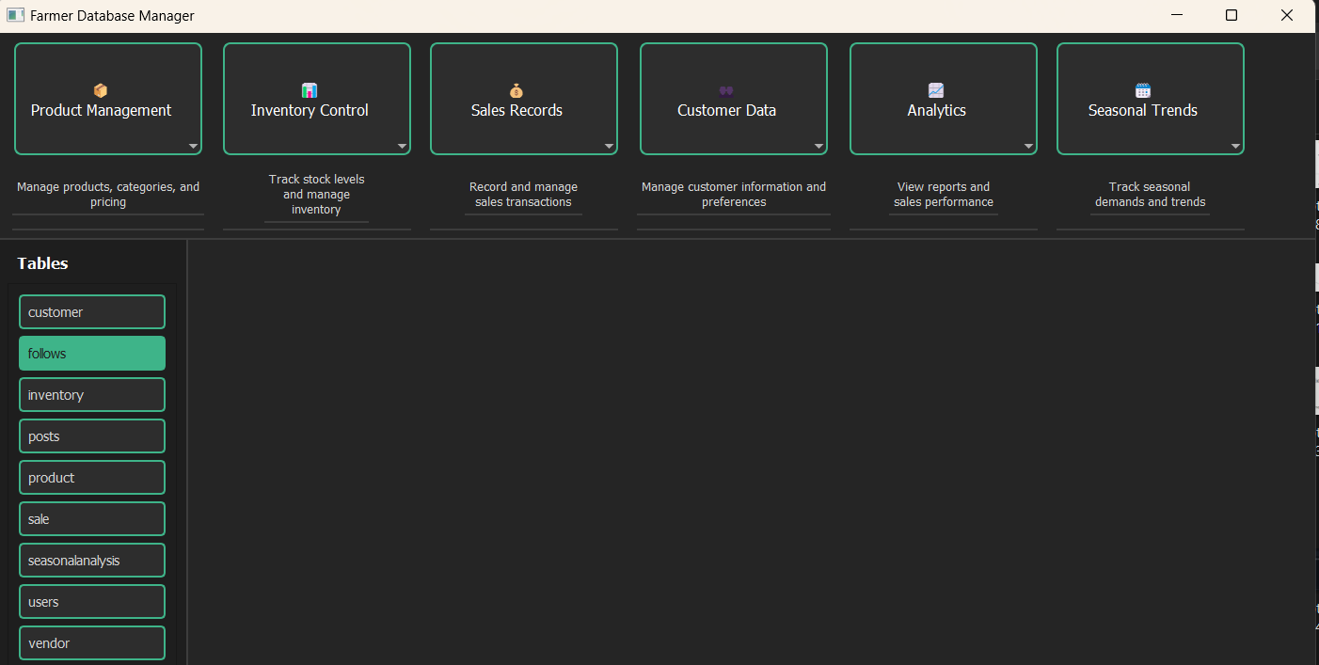
Implementation:

Slide 15
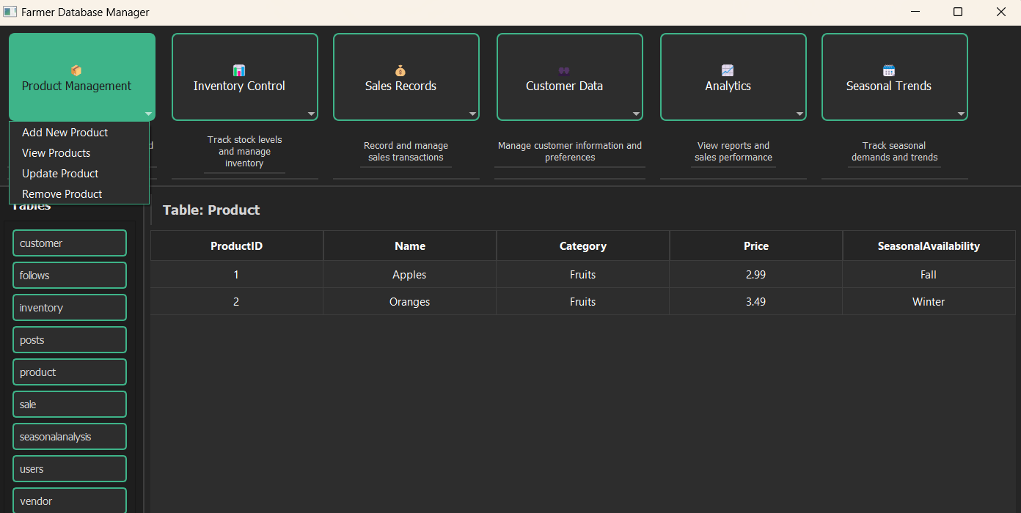

Slide 16
Tools and Technologies
Database Management:
MySQL Workbench: For designing the Entity-Relationship Diagram (ERD).
Python: For backend logic and data processing.
Seasonal Algorithms: Custom Python scripts to analyze historical sales data and predict future trends.
Security and Testing
Data Validation: Ensuring accurate and secure data entry.
Unit and Stress Testing: Mock data tests for performance evaluation

Slide 17
Features:
Seasonal trend analysis.
Real-time inventory tracking.
Customer preferences tracking.
Sales reporting and insights.
Reduces waste and optimizes stock levels.
Improves decision-making for vendors.

Slide 18
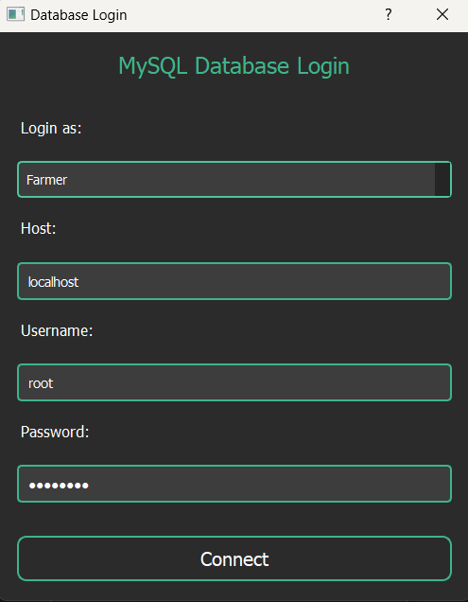
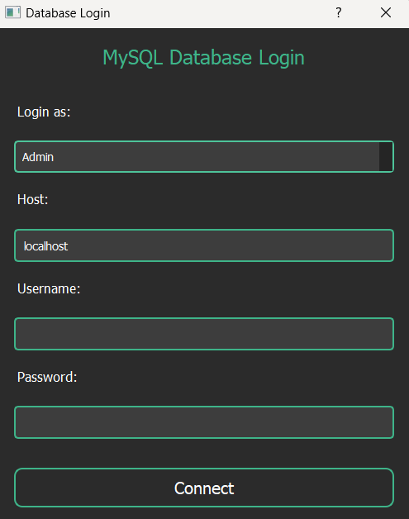
Admin View/ Farmer View(Login Functionality)

Slide 19
Testing and Validation:
Testing Scenarios:
Validate database integrity (e.g., foreign key constraints).
Test edge cases (e.g., empty inventory or invalid inputs).
Ensure accurate seasonal trend predictions.
Results:
All operations executed successfully.
Queries produced expected outputs.

Slide 20
Results:
Key Outcomes:
Efficient inventory management for vendors.
Seasonal trend analysis ensures optimal stock levels.
User-friendly interface enhances vendor satisfaction.
Future Recommendations:
Add mobile app support for remote access.
Implement AI for advanced demand forecasting.
Scale the system for multiple markets

Slide 21
Conclusion:
Summary:
The Inventory Management System for a Local Farmer’s Market successfully addresses key challenges faced by vendors, such as managing inventory, tracking sales, and forecasting seasonal demand.
The system provides real-time updates, accurate data insights, and a user-friendly interface to enhance vendor efficiency and customer satisfaction.

Slide 22
Impact:
Efficiency: Vendors can optimize stock levels, reducing waste and minimizing stockouts.
Decision-Making: Sales and seasonal trend analysis supports better planning and business decisions.
Scalability: The system’s modular design ensures it can be expanded to support additional vendors or markets.
Closing Statement:
The project demonstrates the application of database management and analysis to solve real-world challenges, benefiting both vendors and customers in the farmer’s market ecosystem.

Slide 23
Teamwork and Collaboration:
Collaboration Overview: Weekly meetings to monitor progress.
Tools: Slack, Zoom, Google Drive for communication and resource sharing.
Individual Contributions:
Shubh Patel: Database design and SQL development.
Jeet Patel: ERD creation and backend implementation.
Omkar Datta : UI design and integration.
Jagruth Reddy : Requirements gathering and reporting.
Bhanu Prakash Reddy : Seasonal analysis module.
Manasa Tallapaka : Security and authentication(Login Page).

Slide 24
THANK YOU
Any Question?

